Slide 1

SCHOOL OF COMPUTER SCIENCE AND ENGINEERING
DEPARTMENT OF COMPUTER SCIENCE AND ENGINEERING
EMOTIONAI: CONTEXT & CONVERSATION-AWARE EMOTION DETECTION
Submitted By:
Kakul Barsaiya
23FE10CSE00261
Supervised By:
Dr. Shikha Mundra

Slide 2
OVERVIEW
Methodology
Model Evolution
Introduction
Literature Review
Results
Problem Statement
Objective
Outcome
References

Slide 3
INTRODUCTION
There are social networking sites like Twitter that have an enormous amount of text-based data being produced every day through which people share their feelings, viewpoints, and personal stories. Feelings may include happiness, joy, sadness, anger, and fear, among others. Emotion detection is basically meant to help computers comprehend human emotions through text data.
This feature can be extremely useful in many practical applications such as mental state tracking, consumer mood evaluation, and improving the performance of chatbots and recommendation engines. The system's ability to correctly detect emotions will help it generate appropriate responses.

Slide 4
NEED OF PROJECT
Traditional models analyze only a single sentence
They ignore previous conversation or context
Emotions are often dependent on past messages
Example:
“I’m fine” can mean different things based on context
Therefore, a context-aware system is required

Slide 5
LITERATURE REVIEW
Author (Year) | Model Used | Approach Type | Work Description
Go et al. (2009) | Naive Bayes, SVM | Single Text Classification | Performed sentiment analysis using traditional machine learning techniques on text data
Kim (2014) | CNN | Emotion Same | Applied convolutional neural networks for sentence classification and feature extraction
Hochreiter & Schmidhuber (1997) | LSTM | Emotion Same | Introduced LSTM for capturing sequential dependencies in text
Poria et al. (2017) | LSTM + Attention | Emotion Shift | Proposed context-aware emotion detection using previous utterances
Majumder et al. (2019) | DialogueRNN | Window-3 Context | Modeled conversational context for emotion recognition in dialogues
Devlin et al. (2018) | BERT | Context-Based | Introduced transformer-based bidirectional model for deep contextual understanding
Liu et al. (2019) | RoBERTa | Window-3 Context | Improved BERT with optimized training for better performance
Vaswani et al. (2017) | Transformer | Context-Based | Proposed attention-based architecture for handling long-range dependencies

Slide 6
PROBLEM STATEMENT
To develop an emotion detection system that accurately predicts emotions from text using contextual and conversational understanding instead of isolated sentences.

Slide 7
OBJECTIVES
To build an emotion classification system
To compare multiple models (TF-IDF, BERT, RoBERTa)
To improve accuracy using contextual information
To preprocess and clean textual data
To analyze model performance using evaluation metrics
To implement context and conversation-based prediction
To develop an interactive and user-friendly web interface

Slide 8
MODEL USED & SYSTEM FEATURES
Model Used
1. TF-IDF + ML Model
Converts text → numerical vectors
Used with Logistic Regression / Naive Bayes
Fast but less accurate
2. BERT
Understands bidirectional context
Better accuracy
Used for contextual prediction
3. RoBERTa
Improved version of BERT
Better training & performance
Used for advanced emotion detection
System Features
Single Text Emotion Detection
Contextual Emotion Detection
Conversation History Analysis
Multi-model comparison
Explainable AI (attention/gradients)

Slide 9
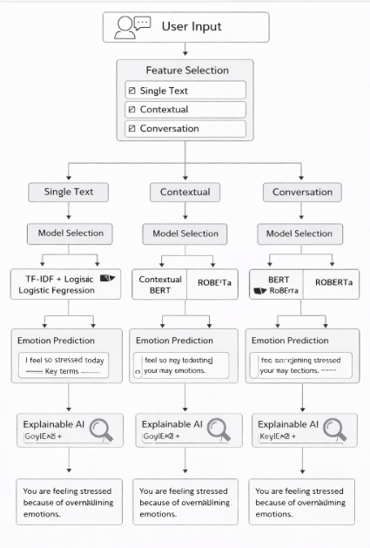
METHODOLOGY
User provides input text
User selects feature type (Single Text / Contextual / Conversation)
Based on selection, appropriate preprocessing is applied
- Text cleaning and tokenization
- Conversion into model-compatible format
Model selection is done based on feature type:
- Single Text: TF-IDF + Logistic Regression, BERT
- Contextual: BERT, RoBERTa
- Conversation: BERT, RoBERTa
Selected model predicts the emotion from input text
Explainable AI (XAI) is applied to highlight important words contributing to the prediction
LLM (Gemini) generates a human-readable explanation for why that emotion was predicted
Final output is displayed:
- Predicted Emotion
- Explanation of prediction

Slide 10
MODEL EVOLUTION / COMPARISON
Type | Strength | Limitations | Model | Accuracy
Traditional ML | Fast, Simple | No Context Understanding | TF-IDF + Logistic Regression | 36.4
Deep Learning | Understands bidirectional context, better accuracy | Computationally expensive | BERT Transformer | 48.7
Advanced Transformer | Improved training, best performance, strong context understanding | High resource usage | RoBERTa | 90.46

Slide 11
CONTEXT LABEL COMPARISON
Context Label | Description | Accuracy
Emotion Same | Emotion remains consistent | 49.77
Emotion Shift | Emotion changes between messages | 87.22
Window_3 | Uses last 3 messages for deeper understanding | 55.33

Slide 12
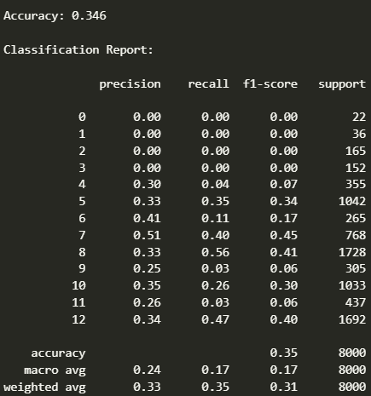
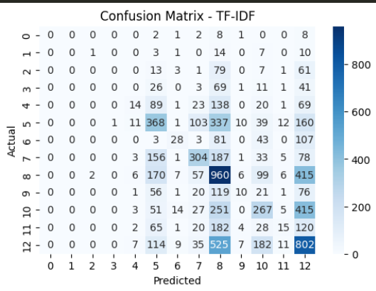
RESULT
Model1:TF-IDF+Logistic Regression
Achieved basic accuracy
Converts text into numerical vectors using word frequency
Performs well on simple and clear sentences

Slide 13
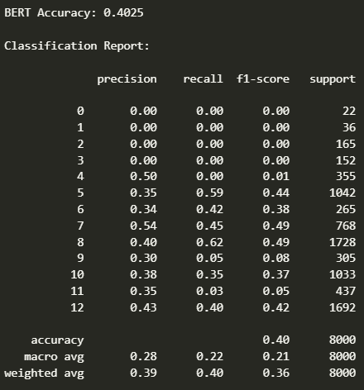
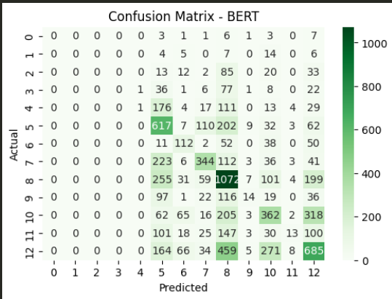
RESULT
Model 2: BERT (Deep Learning)
Achieved good accuracy
Understands bidirectional context
Performs well on contextual inputs

Slide 14
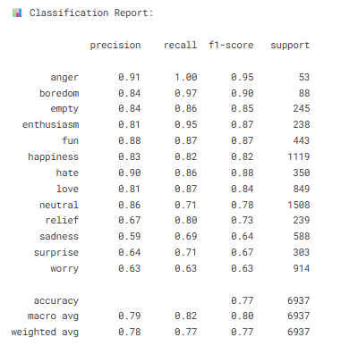
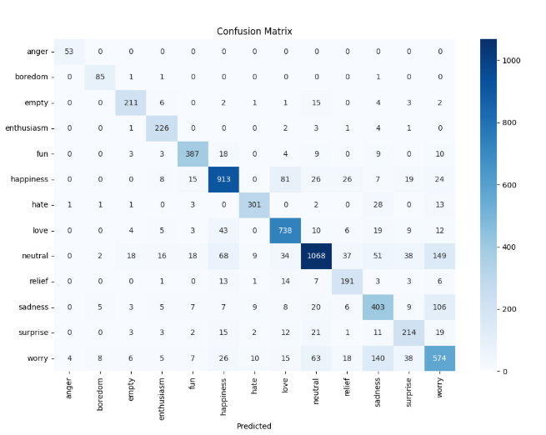
RESULT
Model3: RoBERTa Model
Achieved highest accuracy among all models (~90%+)
Effectively captures contextual and semantic meaning
Performs well on:
Emotion shifts
Ambiguous sentences
Conversation-based inputs

Slide 15
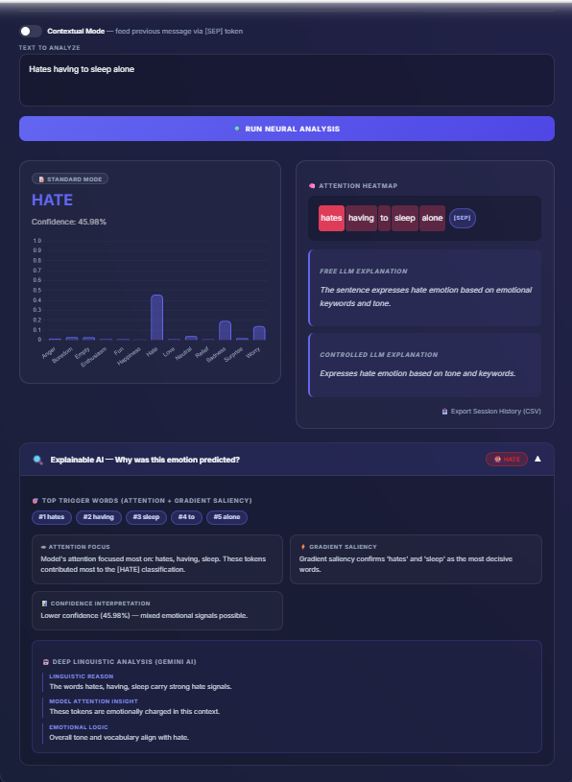
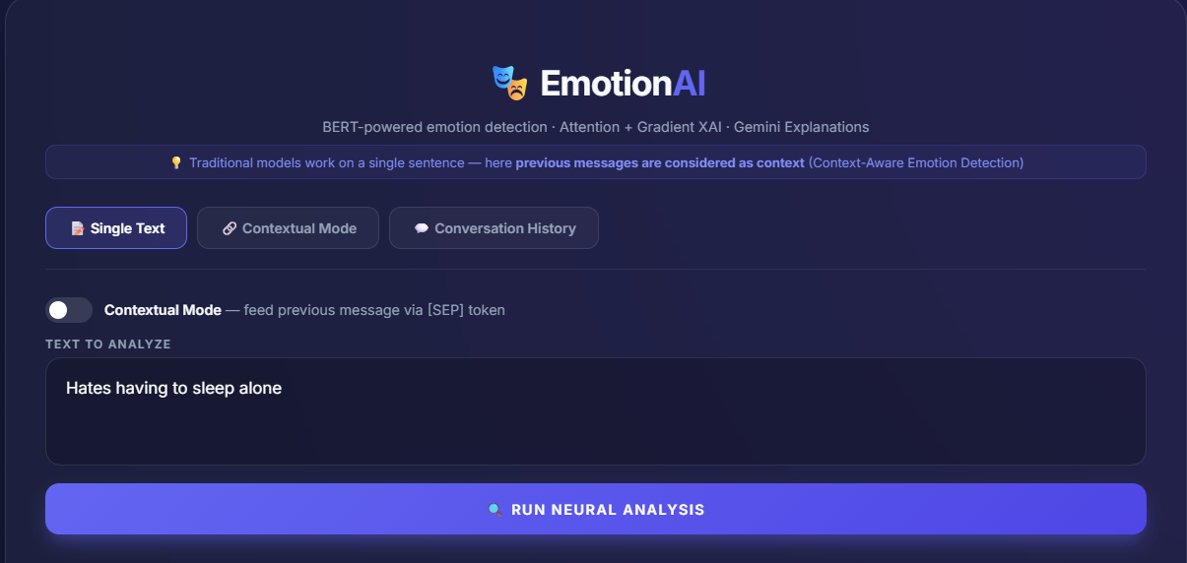
WEB APPLICATION
Single Text:

Slide 16
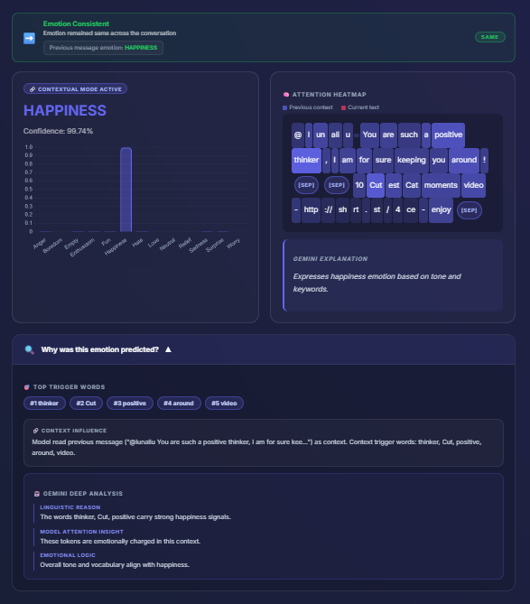
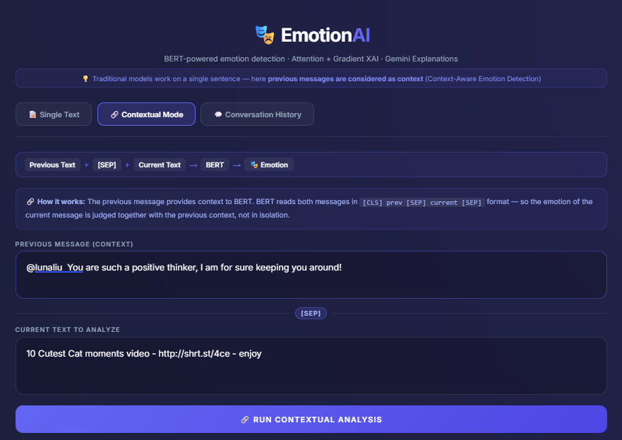
WEB APPLICATION
Contextual

Slide 17
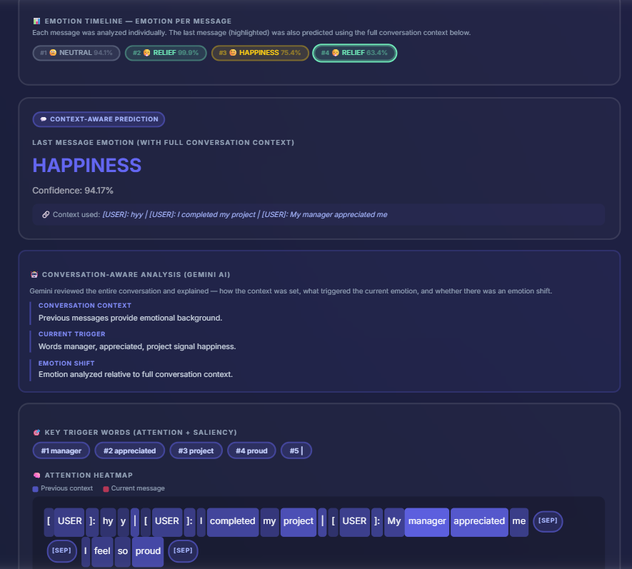
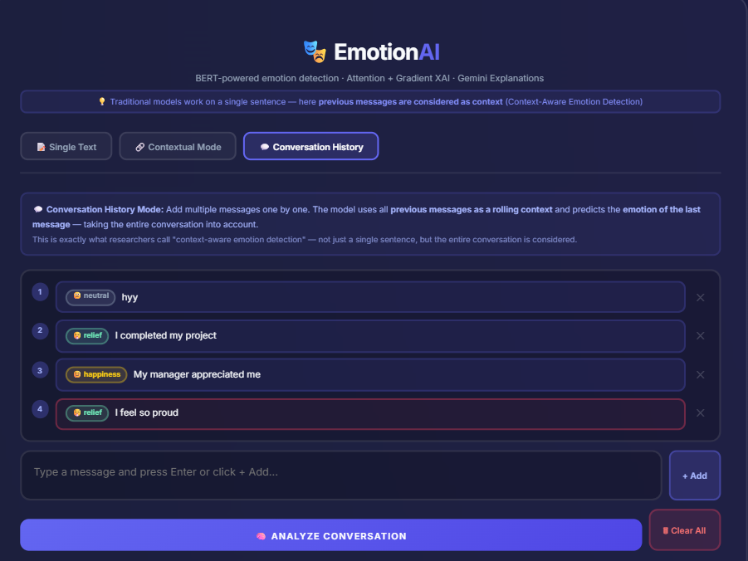
WEB APPLICATION
Conversation History

Slide 18
FUTURE WORK
Add multilingual emotion detection
Integrate real-time social media data
Improve UI/UX
Use advanced models for better accuracy

Slide 19
OUTCOME
Compared tf-idf, bert, and roberta
Achieved best performance using roberta
Implemented context-aware and conversation-based features
Drafted a research paper based on the project

Slide 20
REFRENCE
[1] Devlin, J., Chang, M. W., Lee, K., and Toutanova, K. (2018). “BERT: Pre-training of Deep Bidirectional Transformers for Language Understanding.”
[2] Liu, Y., Ott, M., Goyal, N., et al. (2019). “RoBERTa: A Robustly Optimized BERT Pretraining Approach.”
[3] Pedregosa, F., Varoquaux, G., Gramfort, A., et al. (2011). “Scikit-learn: Machine Learning in Python.” Journal of Machine Learning Research.
[4] Vaswani, A., Shazeer, N., Parmar, N., et al. (2017). “Attention is All You Need.” Advances in Neural Information Processing Systems.
[5] HuggingFace. “Transformers Documentation.” Available at: https://huggingface.co (Accessed: 2026).
[6] Kaggle. “Tweet Emotion Dataset.” Available at: https://www.kaggle.com (Accessed: 2026).

Slide 21
Thank You

